Slide 1
Operating System -- Security
This lecture slide is mainly based on the power point slides by Professor Lawrie Brown, and Dr. Junjie Zhang.
Notes:
OS: Controls and coordinates the use of the hardware among the various application programs.

Slide 2
Security in Operating Systems
OS: Controls and coordinates the use of the hardware among the various application programs.
Originally no operating systems, users entered binary directly with physical switches
Executives were rudimentary utilities to assist programmers
Multiprogrammed operating systems actively oversaw each program's execution
Operating systems mean that several aspects of computing systems require protection:
Memory, shareable I/O (disks, etc.), serial I/O (printers, etc.), sharable programs and subprocedures, networks, sharable data
Notes:
OS: Controls and coordinates the use of the hardware among the various application programs.
Operating system manages system resources, creating an environment that can be shared by multiple processes, and abstract away the low-level hardware details
(1) Operating system is a piece of software
(2) Operating system integrates security mechanisms to enforce security policies
(3) Operating system is very complicated
(4) OS protects the security of hardware and software
OS: (1) separation of User space and OS Kernel space
(2) Separation of processes
OS: Sharing resources: Share library functions, share physical memory, share caches

Slide 3
What Security Goals Does Operating System Provide?
Originally: time-sharing computers: enabling multiple users to securely share a computer
Separation and sharing of processes, memory, files, devices, etc.
What is the threat model?
Users may be malicious, users have terminal access to computers, software may be malicious/buggy, and so on
Security mechanisms
Memory protection
Processor modes
User authentication
File access control
Notes:
Operating system manages system resourses, and abstract away the low-level hardware details
(1) Operating system is a piece of software
(2) Operating system integrates security mechnisms to enforce security policies
(3) Operating system is very complicated
(4) OS protects the security of hardware and software
OS: (1) separation of User space and OS Kernel space
(2) Seperation of processes
OS: Sharing resources: Share library functions, share physical memory, share caches
Threat model: users may be malicious, users have terminal access to computers, software may be malicious/buggy.

Slide 4
What Security Goals Does Operating System Provide?
More recent past and present: Networked desktop computers: ensure secure operation in networked environment
New threat?
Attackers coming from the network. Network-facing programs on computers may be buggy. Users may be hurt via online communication.
Security mechanisms
Authentication; Access Control
Secure Communication (using cryptography)
Logging & Auditing
Intrusion Prevention and Detection
Recovery
Notes:
Threat model: adversaries control the network; can communicate with computers;
Security Goal: Confidentiality, Integrity, Availability
Principle of Complete Mediation: All accesses to objects be checked to ensure that they are allowed.
Principle of Separation of Privilege: A system should not grant permission based on a single condition.

Slide 5
What Security Goals Does Operating System Provide?
Present and near future: mobile computing devices:
New threat?
Apps (programs) may be malicious.
More tightly connected with personal life of the owner.
Security mechanisms?
Isolation of each app.
Help users assess risks of apps.
Risk communication.

Slide 6
Security is About Reconciling Separation and Sharing
Ensure separation
Physical Separation: processes use different physical objects
Temporal separation - processes are executed at different times
Logical separation - processes operate as if they are the only process
Cryptographical separation - processes conceal data and computations
OS also needs to ensure sharing
Notes:
OS, security principles: Separation of Privilege, Complete Mediation
With more advanced hardware architectures: SGX instructions (Intel Software Guard Extensions (SGX) is a security technology built into Intel processors that helps protect data in use via unique application isolation technology. Selected code and data are protected from modification using hardened enclaves.)

Slide 7
Basic Principles of Operating System Security
Operating system security at several levels:
Do not protect - often for sensitive procedures
Isolate - processes are unaware of presence of one another
Share all or share nothing - owner declares object public or private
Share via access limitation - OS checks user's access to an object
Share by capabilities - dynamic creation of sharing rights for objects
Limit use of an object - determines ways in which an object can be accessed
Notes:
With more advanced hardware architectures: SGX instructions (Intel Software Guard Extensions (SGX) is a security technology built into Intel processors that helps protect data in use via unique application isolation technology. Selected code and data are protected from modification using hardened enclaves.)
Intel Software Guard Extensions (SGX) is a set of instruction codes implementing trusted execution environment that are built into some Intel central processing units (CPUs). They allow user-level and operating system code to define protected private regions of memory, called enclaves.

Slide 8
Computer System Components
Hardware
Provides basic computing resources (CPU, memory, I/O devices).
Operating system
Controls and coordinates the use of the hardware among the various application programs.
Applications programs
Define the ways in which the system resources are used to solve the computing problems of the users.
Users
E.g., people, machines, other computers.

Slide 9
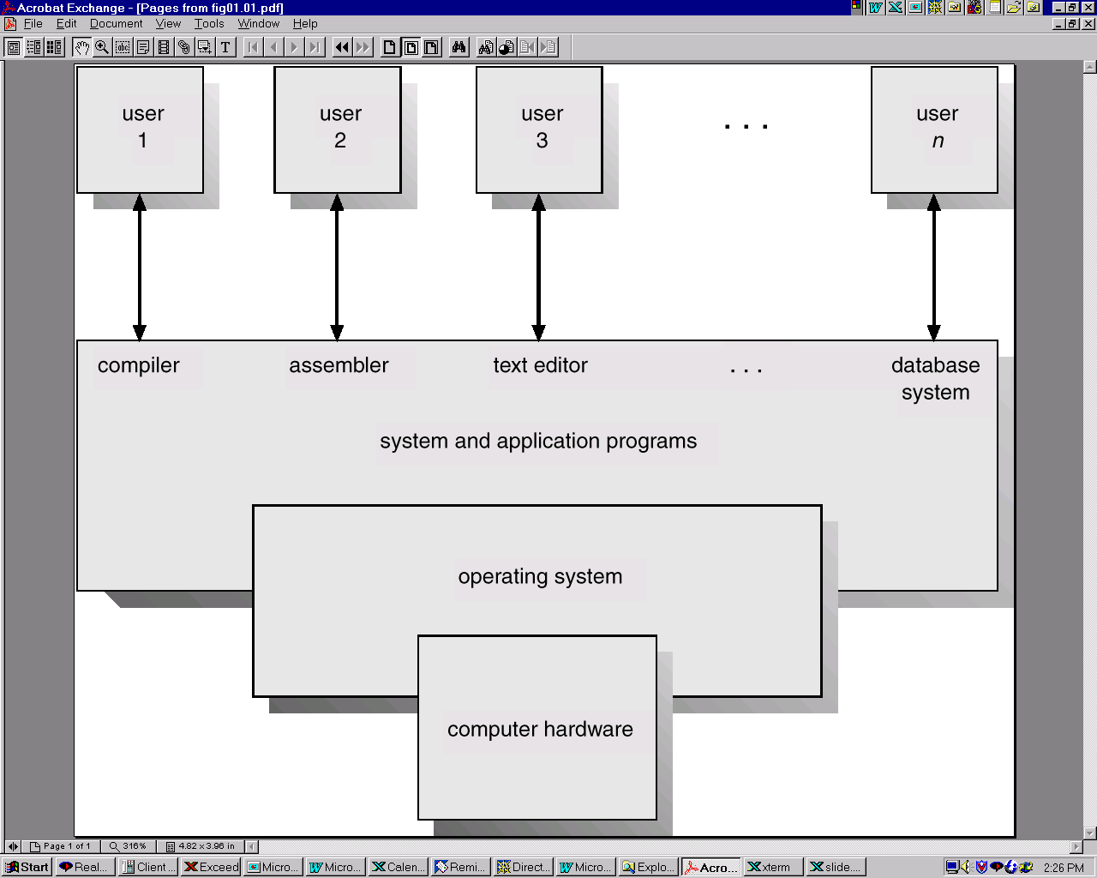
Abstract View of System Components

Slide 10
High-level View of Kernel Space vs. User Space
……
Process 1
Process 2
Process n
The Kernel
Hardware (disks, network interfaces, etc.)

Slide 11
User-Land vs. Kernel-Land
User
Applications
Userland
Non-Essential
OS Applications
Operating
Systems
The OS Kernel
CPU, Memory,
Input/Output
Hardware
Notes:
Briefly review some terminology used throughout the course.

Slide 12
Memory Protection: Access Control to Memory
Ensures that one user’s process cannot access other’s memory
fence
relocation
base/bounds register
segmentation
paging
…
Operating system and user processes need to have different privileges
Kernel needs to maintain separation among user processes.
OS kernel needs to access all memory, and user processes cannot
Kernel needs to have more power than user processes.
Notes:
Kernel needs to maintain separation among user processes.
OS kernel needs to access all memory, and user processes cannot
Kernel needs to have more power than user processes.
Earliest PC are not like this. In MS DOS, all processes have the same power.
Use segments to contain logically related things
code, data, stack
can vary in size but are generally large.

Slide 13
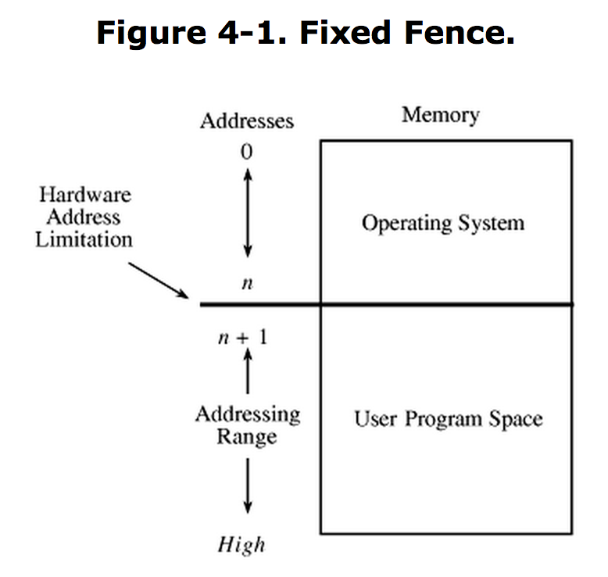
Memory and Address Protection
Aimed at preventing one program from affecting data and programs in memory space of other users
A fence confines users to one side of a boundary
Originally checked if above a predefined memory address to
Required predefined space for OS, needed or not
Notes:
System calls.
Use segments to contain logically related things
code, data, stack
can vary in size but are generally large.

Slide 14
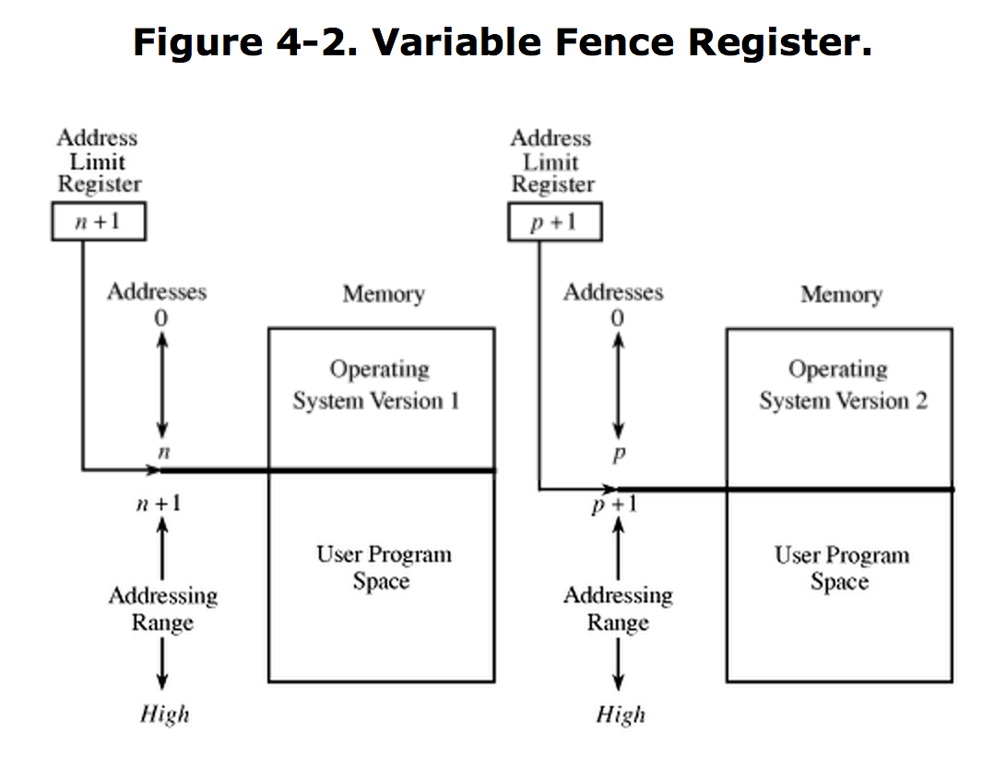
Hardware Fence
Each process has its own virtual address space.
The virtual address space will be translated to the physical address.
Hardware register (fence register) contained address of end of OS
As operating system needs less space, fence register can contain address of lower address
Variable fence register often called a base register
Notes:
Each process has its own virtual address space.
The virtual address space will be translated to the physical address.

Slide 15
Relocation
If the size of the operating system is allowed to change, programs have to not depend on a program or data structure being at a specific address
Relocation updates all the program's initial addresses (starting from 0) to reflect the actual address located in memory. Usually uses a constant relocation factor
Each user has its own address space, which is the range of addresses its processes can run in
Notes:
Each process has its own virtual address space.
The virtual address space will be translated to the physical address.

Slide 16
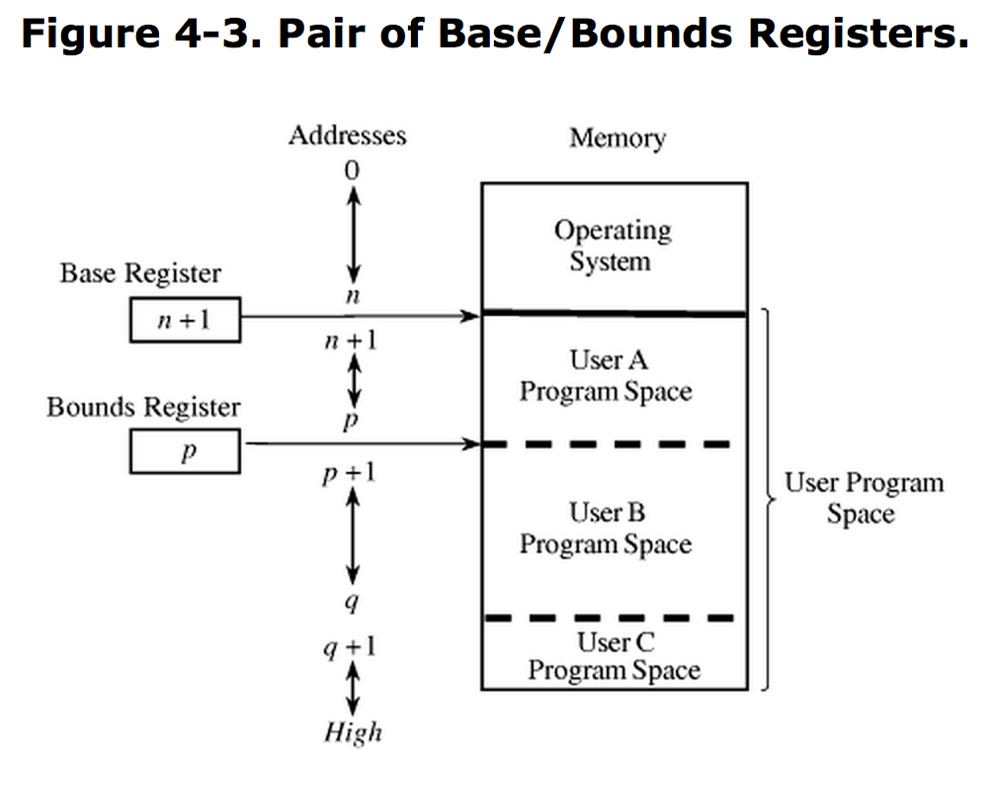
Base and Bounds Registers
Base register has bottom of the process
Bounds register has upper limit of the process
A context switch changes the base and bounds registers from one user's processes to another user's processes
Reduces effect of data-manipulating instructions
Encapsulate instructions with one pair of registers, data with another pair
Notes:
OS segmenation: OS Segmentation is another memory management technique that gives the user's view of a process. The user's view is mapped into the Physical Memory. In Segmentation, a process is divided into multiple segments. The size of each segment is not necessarily the same which is different from paging.
Code segment, data segment, stack segment and heap segments.
Paging offers efficiency and segmentation offers logical protection
They are often combined to take advantage of the strengths of each
Programs divided into logical segments
Each segment broken into fixed-size pages
Retains logical unity of segmentation, provides differentiated protection for segments
Added additional layer of translation for each address

Slide 17
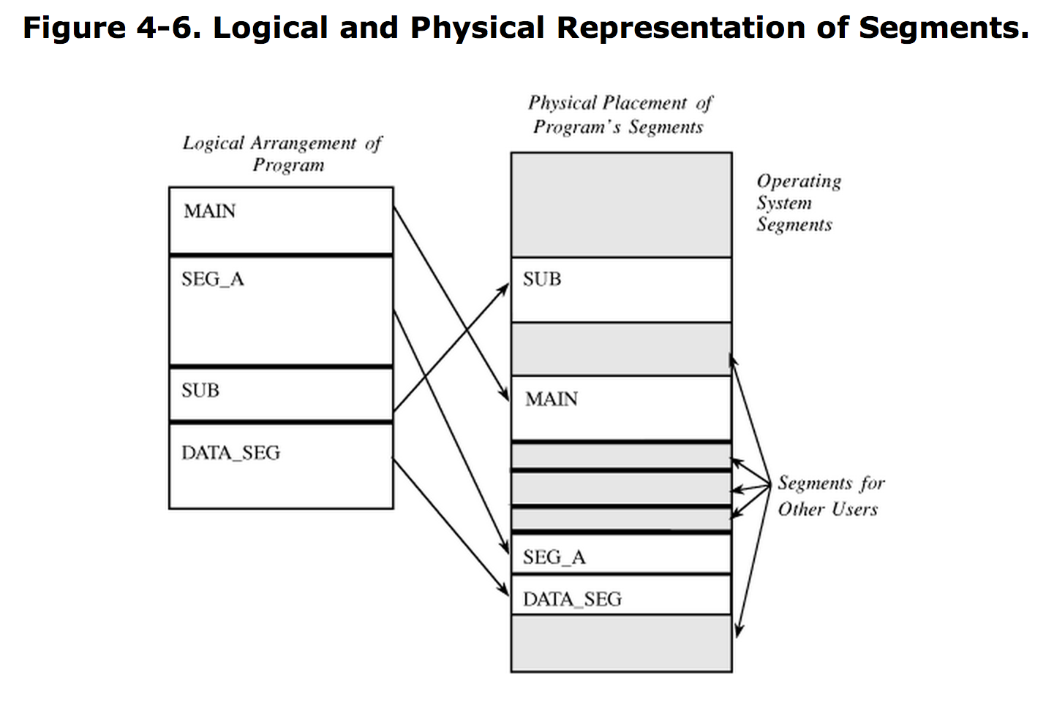
Logical and Physical Segments

Slide 18
Segment Addresses
Program has an address given by <name, offset>, and the operating system looks up name and finds its real start address
Address + offset
Usually one operating system segment address table for each process (unless processes need to share access to segments)
User's program doesn't know what true memory address it uses
OS can move segments around, even after program starts
Segment can be removed from main memory and stored
OS has ability to check each address reference for protection

Slide 19
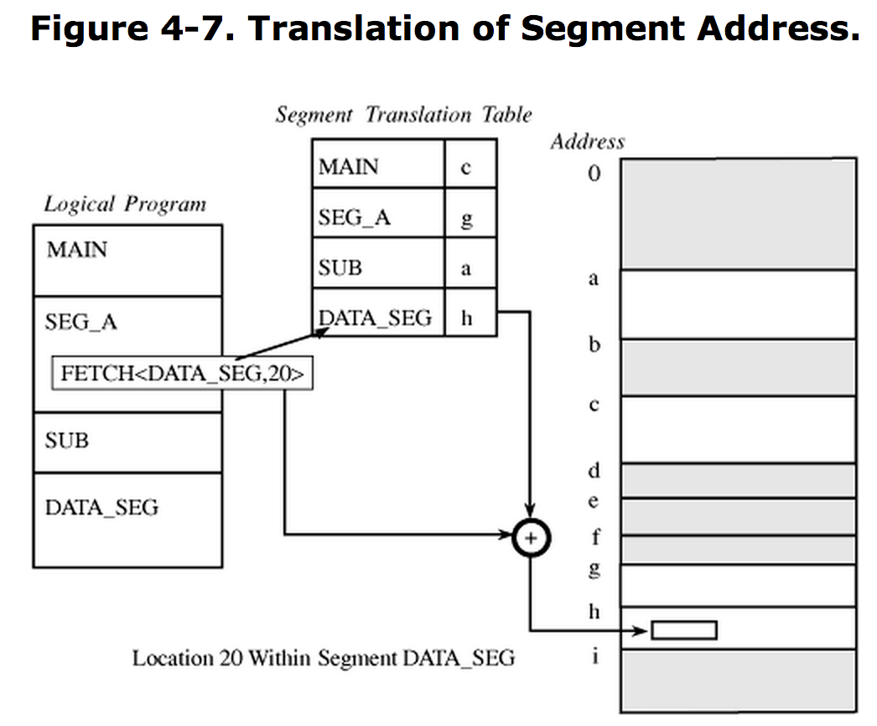
Segment Addresses

Slide 20
Segmentation, contd.
Program can only access a segment if the segment is in it's process segment translation table
One segment could be read-only data, another execute-only code, a third might be writable data
Several advantages:
Each address reference is checked for protection
Classes of data items can be assigned different levels of protection
Multiple users can share access to a segment with different rights
User can't generate an address or access an unpermitted segment

Slide 21
Segmentation, contd.
Each segment has particular size
However, program can generate reference past segment bounds:
<SegmentA, 9999> in a 200 byte segment
Can't be stopped during compilation or at loading time, because segments have to be able to grow during execution (so the bounds are not known in advance)
Segmentation systems must check if address is beyond segment length in the segment translation table
Segment names are converted to segment numbers by the compiler when the program is translated
Compiler appends linkage table that matches numbers to segment names

Slide 22
Paging
In paging, a program is divided into equal-size pieces called pages (power of 2 between 512 and 4096 bytes), and then into page frames
Each address given by <page, offset>
The page portion is converted to page frame address through table lookup
The offset portion is added to the page frame address to produce the real memory address of <page, offset>
true_address = page + offset

Slide 23
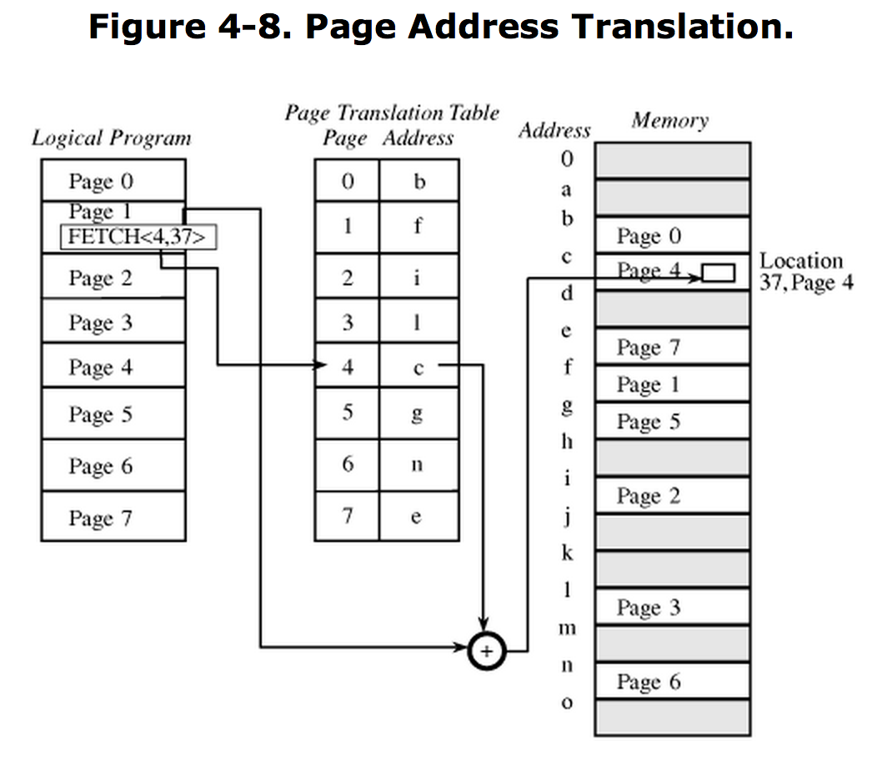
Page Translation
Notes:
While doing the address translation, you can enforce the access control

Slide 24
Memory Pages
All pages in paging approach are fixed size (unlike segmentation)
No problem addressing beyond end of a page
Page can only fit in the available page in memory based on bit-length of the offset value
Example:
Page size of 1024 bytes = 2¹⁰
10 bits allocated for offset of each address
Can't generate offset larger than 1023
Any location after <x, 1023> causes carry into page portion moving into the next page (but not past the last page)

Slide 25
Combined Paging and Segmentation
Paging offers efficiency and segmentation offers logical protection
They are often combined to take advantage of the strengths of each
Programs divided into logical segments
Each segment broken into fixed-size pages
Retains logical unity of segmentation, provides differentiated protection for segments
Added additional layer of translation for each address
Notes:
Paged segmentation: Combined Paging and Segmentation
While doing the address translation, you can enforce the access control

Slide 26
CPU Modes (a.k.a. processor modes or privilege
System mode (privileged mode, master mode, supervisor mode, kernel mode)
Can execute any instruction
Can access any memory locations, e.g., accessing hardware devices,
Can enable and disable interrupts,
Can change privileged processor state,
Can access memory management units,
Can modify registers for various descriptor tables .
Reading: http://en.wikipedia.org/wiki/CPU_modes
Notes:
The separation from different modes are like walls, protecting the kernel from the other processes.

Slide 27
User Mode
User mode
Access to memory is limited,
Cannot execute some instructions
Cannot disable interrupts,
Cannot change arbitrary processor state,
Cannot access memory management units
Transition from user mode to system mode can only happen via well defined entry points, i.e., through system calls
Reading: http://en.wikipedia.org/wiki/CPU_modes
Notes:
A wall separates the user mode with the system mode.
The wall need gates; and system call are the gates.

Slide 28
System Calls
Guarded gates from user mode (space, land) into kernel mode (space, land)
use a special CPU instruction (often an interruption), transfers control to predefined entry point in more privileged code; allows the more privileged code to specify where it will be entered as well as important processor state at the time of entry.
the higher privileged code, by examining processor state set by the less privileged code and/or its stack, determines what is being requested and whether to allow it.
http://en.wikipedia.org/wiki/System_call

Slide 29
Tagged Architecture
Compiler or program loader can rearrange a program so all code sections are adjacent and all data sections are adjacent
May want to allow data to be written at program initialization, but not modified later
Base/bounds registers force all-or-nothing sharing situations
A tagged architecture provides every word of machine memory with one or more access bits, set by OS instructions and tested at run-time
Notes:
tagged architecture: example: non executable stack
A tagged architecture providing every word of machine memory with one or more access bits is too expensive, so usually a tag is for a memory region, not for a memory word.

Slide 30
Kernel space vs User space
Part of the OS runs in the kernel model
known as the OS kernel
Other parts of the OS run in the user mode, including service programs (daemon programs), user applications, etc.
they run as processes
they form the user space (or the user land)
What is the difference between kernel mode and processes running as root (or superuser, administrator)?

Slide 31
User-Land vs. Kernel-Land
User
Applications
Userland
Non-Essential
OS Applications
Operating
Systems
The OS Kernel
CPU, Memory,
Input/Output
Hardware
Notes:
Briefly review some terminology used throughout the course.

Slide 32
Access control
A reference monitor mediates all access to resources
Principle: Complete mediation: control all accesses to resources
Reference
monitor
?
Resource
User process
access request
policy
Notes:
System call gates actually performs access control.
Principle of Complete Mediation: All accesses to objects be checked to ensure that they are allowed.
Principle of Separation of Privilege: A system should not grant permission based on a single condition.

Slide 33
SUBJECTS
A subject is a program (application) executing on behalf of some principal(s)

Slide 34
OBJECTS
An object is anything on which a subject can perform operations (mediated by rights)
Usually objects are passive, for example:
File
Directory (or Folder)
Memory segment
But, subjects (i.e. processes) can also be objects, with operations performed on them
kill, suspend, resume, send interprocess communication, etc.

Slide 35
Basic Concepts of UNIX Access Control: Users, Groups, Files, Processes
Each user account has a unique UID
The UID 0 means the super user (system admin)
A user account belongs to multiple groups
Subjects are processes
associated with uid/gid pairs, e.g., (euid, egid), (ruid, rgid), (suid, sgid)
Objects are files
Notes:
Euid: effective user id, Egid: effective group id
Ruid: Real user id, Rgid: real group id.
Suid: set user id, sgid: set group id. Suid sometimes represents saved uid.

Slide 36
Access Control Matrix
Subjects (users) index the rows
Objects (resources) index the columns
Accounting
program
Accounting
data
Insurance
data
Payroll
data
OS
rx | rx | r | --- | ---
rx | rx | r | rw | rw
rwx | rwx | r | rw | rw
rx | rx | rw | rw | rw
Bob
Alice
Sam
Accounting
program

Slide 37
Are You Allowed to Do That?
Access control matrix has all relevant info
Could be 1000’s of users, 1000’s of resources
Then matrix with 1,000,000’s of entries
How to manage such a large matrix? Might become a performance bottle neck.
Need to check this matrix before access to any resource is allowed
How to make this efficient?

Slide 38
Access Control Lists (ACLs)
ACL: store access control matrix by column
Example: ACL for insurance data is in blue
Accounting
program
Accounting
data
Insurance
data
Payroll
data
OS
rx | rx | r | --- | ---
rx | rx | r | rw | rw
rwx | rwx | r | rw | rw
rx | rx | rw | rw | rw
Bob
Alice
Sam
Accounting
program

Slide 39
Access Control Lists (ACLs)
ACL: store access control matrix by column
Example: ACL for insurance data is in blue
Insurance data:
(Bob, ---), (Alice, rw), (Sam, rw), (accounting program, rw)
Notes:
Windows has two forms of access control list (ACL). The first is Discretionary ACL (DACL), which grants or denies access to protected resources in Windows such as files, shared memory, named pipes, and so on. The other kind of ACL is the System ACL (ACL), which is used for auditing and in Windows Vista used to enforce mandatory integrity policy.

Slide 40
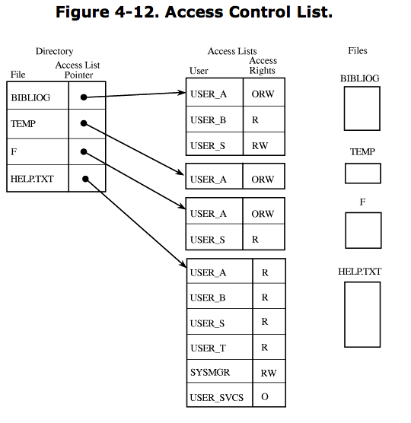
Access Control List (ACL)
One list for each object, showing subjects and their access
ORW: read, write, and execute along with owner access
Notes:
ORW: read, write, and execute along with owner access

Slide 41
Capabilities (or C-Lists)
Store access control matrix by row
Example: Capability for Alice is in red
Accounting
program
Accounting
data
Insurance
data
Payroll
data
OS
rx | rx | r | --- | ---
rx | rx | r | rw | rw
rwx | rwx | r | rw | rw
rx | rx | rw | rw | rw
Bob
Alice
Sam
Accounting
program

Slide 42
Capabilities (or C-Lists)
Store access control matrix by row
Example: Capability for Alice is in red
Alice: (OS, rx), (accounting program, rx), (accounting data, r),
(insurance data, rw), (payroll data, rw).

Slide 43
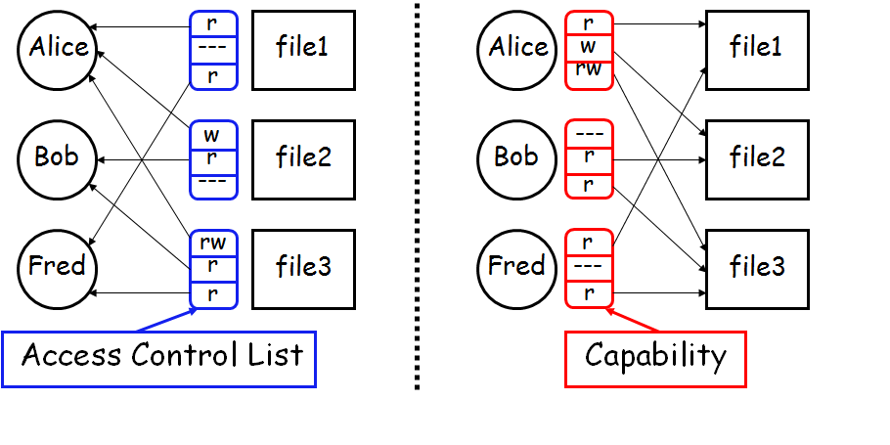
ACLs vs Capabilities
Note that arrows point in opposite directions…
With ACLs, still need to associate users to files

Slide 44
Confused Deputy
Two resources
Compiler and BILL file (billing info)
Compiler can write file BILL
Alice can invoke compiler with a debug filename
Alice not allowed to write to BILL
Access control matrix
Compiler
BILL
x | ---
rx | rw
Alice
Compiler

Slide 45

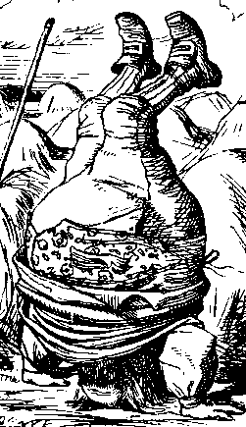

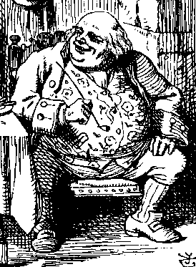
ACL’s and Confused Deputy
debug
BILL
filename BILL
Compiler
Alice
BILL
Compiler is deputy acting on behalf of Alice
Compiler is confused
Alice is not allowed to write BILL
Compiler has confused its rights with Alice’s

Slide 46
Confused Deputy
Compiler acting for Alice is confused
There has been a separation of authority from the purpose for which it is used
With ACLs, difficult to avoid this problem
With Capabilities, easier to prevent problem
Must maintain association between authority and intended purpose
Capabilities make it easy to delegate authority

Slide 47
ACLs vs Capabilities
ACLs
Good when users manage their own files
Protection is data-oriented
Easy to change rights to a resource
Capabilities
Easy to delegate---avoid the confused deputy
Easy to add/delete users
More difficult to implement
The “Zen of information security”
Capabilities loved by academics
Capability Myths Demolished

Slide 48
Multilevel Security
Users with different needs to know sharing computer or network
If don’t need to know – shouldn’t even be able to determine if information exists
Should be able to filter functionality based on allowable information
Mandatory and Discretionary protections
Mandatory access control: (MAC) is an access policy determined by the system, not the owner. MAC is used in multilevel systems that process highly sensitive data, such as classified government and military information.
Discretionary access control: (DAC) is an access policy determined by the owner of an object. The owner decides who is allowed to access the object and what privileges they have.
Notes:
Mandatory access control (MAC) is an access policy determined by the system, not the owner. MAC is used in multilevel systems that process highly sensitive data, such as classified government and military information.
Mandatory access control (MAC): denying users full control over the access to resources that they create. The system security policy (as set by the administrator) entirely determines the access rights granted
Discretionary access control: (DAC) is an access policy determined by the owner of an object. The owner decides who is allowed to access the object and what privileges they have.

Slide 49
Mandatory Access Control (MAC)
Operating systems traditionally had discretionary access control (DAC) to limit access to files and other objects (for example UNIX file permissions and Windows access control lists (ACLs))
Discretionary is a weakness – users / admins need to do something to increase protection
Stronger form is mandatory access control, which even root user can’t circumvent
Makes resources inaccessible except to their intended owners
Modern systems implement both MAC and DAC, with MAC usually a more secure, optional configuration (Trusted Solaris, TrustedBSD (used in macOS), SELinux), Windows Vista MAC)
At its heart, labels assigned to objects and subjects (including processes)
When a subject requests access to an object, policy checked to determine whether or not a given label-holding subject is allowed to perform the action on the object

Slide 50
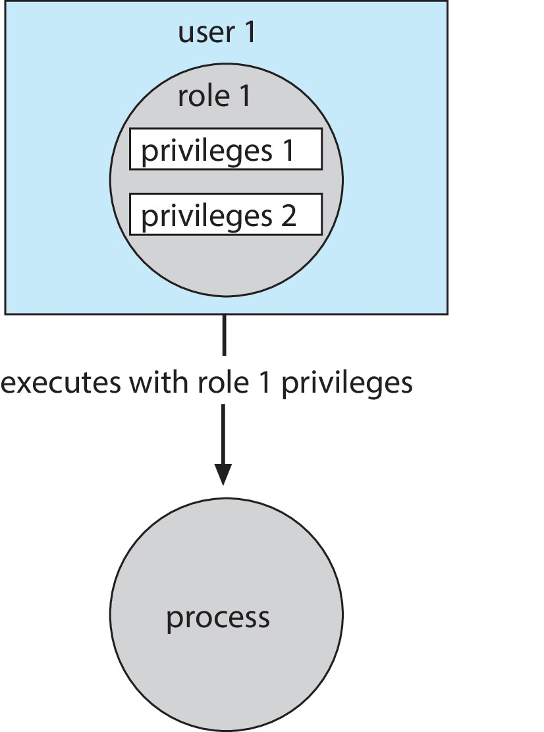
Role-based Access Control
Protection can be applied to non-file resources
Oracle Solaris 10 provides role-based access control (RBAC) to implement least privilege
Privilege is right to execute system call or use an option within a system call
Can be assigned to processes
Users assigned roles granting access to privileges and programs
Enable role via password to gain its privileges
Similar to access matrix

Slide 51
Role-Based Access Control
Role-based access control associates privileges with groups
Administrators, faculty, teaching assistants, students
Access control changes user's role to provide needed privileges

Slide 52
User Policy
Restricting access
commands
file access
login times
network access
terminal access
Inactive users
Detection
Password change
Locking (change shell)
Deletion (after backup)
Ultimately - need multilevel security

Slide 53
Monitor Model
General Schema:
Takes user's request.
Consults access control information.
Allows or disallows request.
Advantages
Easy to implement.
Easy to understand
Disadvantages
Bottleneck in system
Controls only direct accesses (not inferences)

Slide 54
Military Security Model
Information is ranked:
Unclassified
Confidential
Secret
Top Secret
Least Privilege: Subject should have access to fewest objects needed for successful work
The system backup program may be allowed to bypass read restrictions on files, but it would not have the ability to modify files.
Need to Know

Slide 55
Compartmentalization
Information may belong to one or more compartments
Compartments are used to enforce need-to-know.
Classification of Information: <rank; compartments>
Clearance: <rank; compartments>
an indication of a level of trust
A subject can access an object only if
The clearance level of the subject is at least as high as that of the information.
The subject has a need to know about all compartments for which the information is classified.

Slide 56
Information Flow Models
Acts as an intelligent filter to control the transfer of information permitted by access to a particular object.
Information flow analysis can assure that operating system modules that have access to sensitive data cannot leak that data to calling modules.

Slide 57
Bell-LaPadula Model
A formal description of the allowable paths of information flow in a secure system.
Applies only to privacy
Identifies paths that could lead to inappropriate disclosures.
Is used as the basis for the design of systems that handle data of multiple levels.
Includes both discretionary and mandatory access rules
B-LP Discretionary Access Control
Uses Access Matrix similar to Graham-Denning Model
Includes functions for dealing with the access matrix.

Slide 58
Bell-LaPadula Mandatory Controls
Fixed security classes for each subject and each object
Security classes ordered by a relation
Tranquility constraint prevents access classes of objects from changing
Simple Security Property
* Property

Slide 59
Bell-LaPadula Properties
Simple Security Property:
Subject may have read access only if object classified at same level or lower.
* - Property
Subject may have write access only if all objects read are at same level or higher than object to be written.

Slide 60
Biba Model
Concerned with integrity rather than secrecy.
Defines integrity levels much like sensitivity levels.
Fixed integrity classes for each subject and each object
Ordered integrity classes

Slide 61
Biba Properties
Simple Integrity Property:
Subject can modify object only if integrity class at least as high as the object. (untrusted subjects reduce integrity class when writing)
* - Property:
Subjects may have write access only if the integrity of objects they are reading is at least as high as the object to be written. (untrusted sources reduce integrity of results)

Slide 62
Integrity Preservation
A high integrity file is one whose contents are created by high-integrity processes.
high-integrity file cannot be contaminated by information from low-integrity processes.
high-integrity process cannot be subverted by low integrity processes or data.
The integrity class label on a file guarantees that the contents came only from sources of at least that degree of integrity.

Slide 63
Windows Vista and later versions-- Six Integrity Levels
Object and Principals are labeled
Untrusted
Low
Medium
High
System
Installer
four primary security levels: low, medium, high, and system.
Notes:
In order to police the interactions between objects, Windows must first determine the trustworthiness, or integrity level of each object. WIC assigns one of the following six integrity levels to each object:
Untrusted. Rarely seen; for anonymous logons.
Low. Internet features (including IE 7 and the Temporary Internet Files folder).
Medium. The default integrity level. Used for Standard User accounts and most files.
High. Administrator accounts.
System. Most of the kernel and system services.
Installer. Why? Because installers need to have a higher integrity level than other objects in order to ensure uninstall works properly.

Slide 64
Secure Operating Systems
Basic Features of a Multiprogramming OS
Authentication of users.
Protection of memory –segmentation, paging, paged segmenation (combining segmentation with paging).
File and I/O device access control.
Allocation and access control to general objects.
Enforcement of sharing.
Guarantee of fair service.
Interprocess communication and synchronization.
Basic Considerations
Security must be considered in every aspect of the design of operating systems.
It is difficult to add on security features.

Slide 65
Basic Design Principles
Least privilege - fewest possible privileges for user.
Economy of mechanism - small, simple, straight forward.
Open design
Complete mediation - check every access
Permission based - default is denial of access.
Separation of privilege - no single super user.
Least common mechanism - avoid shared objects.
Easy to use.

Slide 66
Security Kernel
Responsible for implementing the security mechanisms of the entire operating system.
Provides the security interfaces among the hardware, the operating system, and the other parts of the computing system.
Implementation of a security kernel:
May degrade system performance (one more layer).
May be large.
No guarantees.

Slide 67
Tripwire
A number of commercial and open-source tools available to perform system security scanning and vulnerability testing.
Tripwire is a well-known file integrity checking tool that maintains a database of cryptographic hashes of monitored files and scans to detect any changes, whether as a result of malicious attack or simply accidental or incorrectly managed update. This also was originally an open-source tool but now has both commercial and free variants available.

Slide 68
Strategies to Mitigate Cyber Security Incidents
The Australian Signals Directorate (ASD) list of the “Strategies to Mitigate Cyber Security Incidents”
Allow-list approved applications
Patch third-party applications
Patch operating system vulnerabilities and use the latest versions
Restrict administrative privileges
Configure Microsoft Office macro settings (For Windows OS)
User application hardening
Multifactor authentication
Regular backups
Collectively these assist in creating a defense-in-depth system
NIST SP 800-123: General Server Security

